Slide 1

Customer Product Recommendation Using Association Rule Mining
Sandeep Batta
Kamalesh Kumar MG

Slide 2
01
02
03
INTRODUCTION
DATASET
DATA PREPROCESSING
TABLE OF CONTENTS
04
05
06
DATA MINING
RECOMMENDATION
GENERATION
DEMO

Slide 3

INTRODUCTION
PERSONALIZATION
MARKETING
REVENUE
Personalized product recommendation
Promoting products
RETAIL ENVIRONMENT
Increase product sales

Slide 4

PROJECT IDEA
Objective is to leverage association rule mining, especifically the Apriori algorithm to derive associations among products purchased by customers and generate recommendations based on these associations

Slide 5

DATASET
PRODUCTS
ORDERS
ORDERS & PRODUCT
DEPARTMENTS
AISLES
Product_id, product_name, aisle_id, department_id
order_id, user_id, eval_set order_number, order_dow
order_id, product_id, add_to_cart_order, reordered
department_id, department
aisle_id, aisle

Slide 6

DATA PREPROCESSING
Data Loading
Data Selection
Concatenation and Merging
Aggregation
Load datasets from CSV files
Keep only necessary columns i.e order_id, product_id
Concatenate “train” and “prior” datasets and merge products dataset to get product names
Aggregate products according to order_id

Slide 7

DATA MINING
The Apriori algorithm is a classic association rule mining technique in data mining. It aims to discover frequent itemsets in a transaction database and derive association rules between items based on their frequency of occurrence.

Slide 8

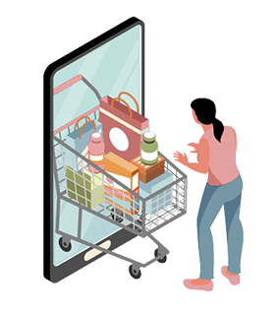
RECOMMENDATION
Generate recommendations based on the associations
PRODUCT IN CART
RECOMMENDATION
Super Spinach! Baby Spinach, Sweet Baby Kale, Banana
Baby Bok Choy

Slide 9
RECOMMENDATION
Generate recommendations based on the associations
PRODUCT IN CART
RECOMMENDATION
Organic Baby Carrots
Bag of Organic Bananas, Banana

Slide 10
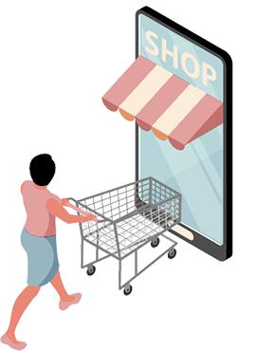
DEMO !

Slide 11

FUTURE DIRECTION
Explore various models for the recommendation generation.
Figure out which is more useful

Slide 12
THANK YOU

